Slide 1


SUNSTONE
“ Calender scheduler application”
Task - 1

Slide 2


SUNSTONE
Project Name : “ Calender scheduler Application ”
In today's fast-paced and dynamic world, effective time management is crucial for both individuals and organizations. The need for a reliable and user-friendly tool to schedule and organize events, meetings, and tasks has never been more significant. To address this demand, we propose the development of a cutting-edge Calendar Scheduler Application.
S.NO | LMS Username | Name | Batch
1 | @jayashri18 | Jayashri V | 4
2 | @gopika20 | Gopika M | 4
3 | @keerthiga2003 | Keerthiga S | 4
4 | @Manthra117 | Manthara G | 4

Slide 3
SUNSTONE
Task-1
Creation of SRS and Github:
Create SRS for Calendar Scheduler Application:
Develop a comprehensive Software Requirements Specification (SRS) outlining key features, user interactions, and technical specifications for the Calendar Scheduler Application.
GitHub Account Setup:
Establish a GitHub account for collaborative version control and project management.
Git Bash Commands Hands-On:
Gain proficiency in essential Git Bash commands for efficient version control.
Perform tasks such as repository creation, branching, and committing.
Evaluation Metric:
Achieve 100% completion of SRS creation and GitHub setup, demonstrating a thorough understanding of Git Bash commands.
Learning Outcome:
Understand various software development lifecycle models.
Grasp the significance of creating a detailed SRS for a Calendar Scheduler Application.
Familiarize yourself with diverse Git commands to manage project versions effectively.
Gain insights into agile and scrum management techniques for streamlined product development.

Slide 4
SUNSTONE
Step-Wise Description
1.Define Scope and Tech Stack
Identify key features: date/time, reminders, recurring events.
Choose a scalable tech stack for efficient development.
2. UI/UX and Frontend:
Design an intuitive, responsive interface.
Develop frontend for seamless user interaction.
3. Functionality and Integration:
Enable easy date/time selection and recurring events.
Integrate with address book for efficient location input.
4.Task Organization:
Implement task prioritization, inspired by a shopping cart concept.
Allow users to categorize and label events for better organization.
5.Testing, Deployment, and Support:
Conduct thorough testing for functionality and security.
Deploy on a reliable platform and provide user support.
Summary of your task
The project aims to develop a calendar scheduler application, minimizing manual scheduling efforts. It will efficiently manage appointments, tasks, and events while providing details on user schedules, ensuring seamless organization.

Slide 5
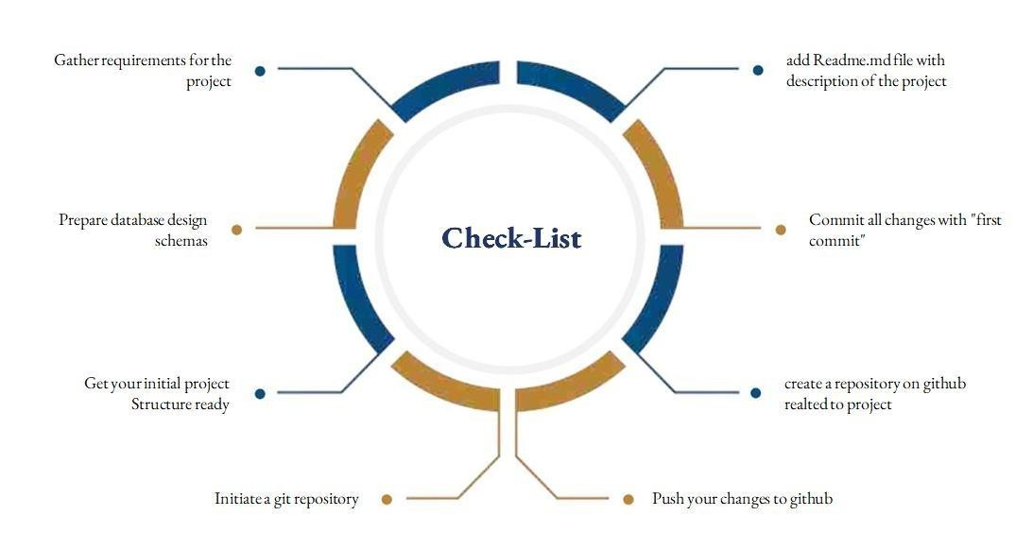
SUNSTONE
Assesment Parameter

Slide 6
Submission Github
SUNSTONE
https://github.com/jayashri-18/NM--AIT--GROUP4.git

Slide 7


SUNSTONE

